Slide 1
Cyclistic Bike-Share Case Study
Capstone Project – Google Data Analytics Professional Certificate (Coursera)
Ali Hamza / January 13th, 2022

Slide 2
Agenda
Introduction
Business Task
Analysis & Findings
Recommendations
Conclusion and Future Extension

Slide 3
Introduction
Welcome to the Cyclistic bike-share analysis case study!
This is a case study from Capstone Project of Google Data Analytics Certification on Coursera.
This work is for a fictional company, Cyclistic, and with different characters and team members.

Slide 4
Business Task
The business task is to identify the different usage of Cyclistic bikes by annual members and casual riders.

Slide 5
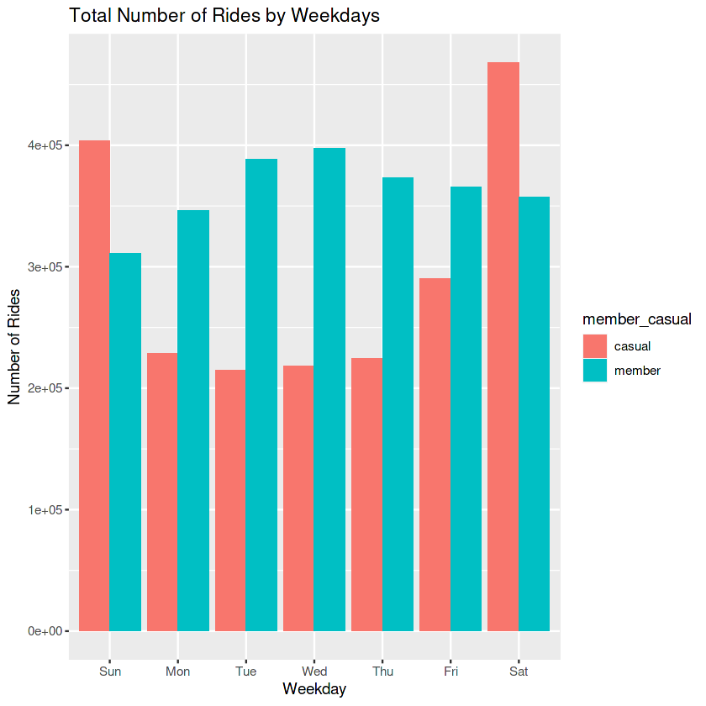
Analysis and Findings
You can see the casual riders are weekend riders mostly when we compare with the number of rides on weekdays of the year 2021.

Slide 6
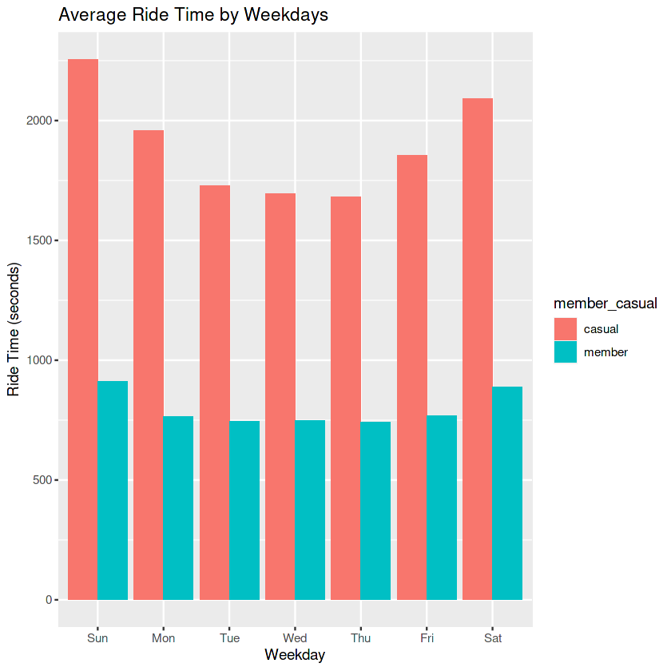
Analysis and Findings
From this image, you can see the average ride time of casual riders are always high than the member riders mostly on weekends.

Slide 7
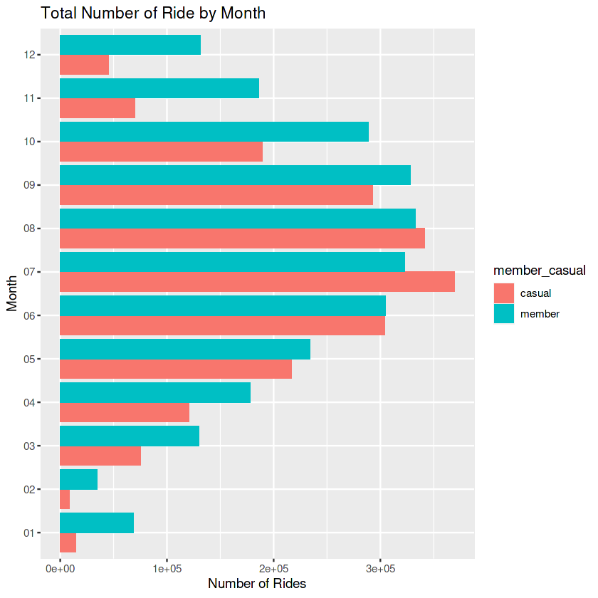
Analysis and Findings
From this image, you can see that number of rides of casual riders are higher than member riders in summer months of the year 2021

Slide 8
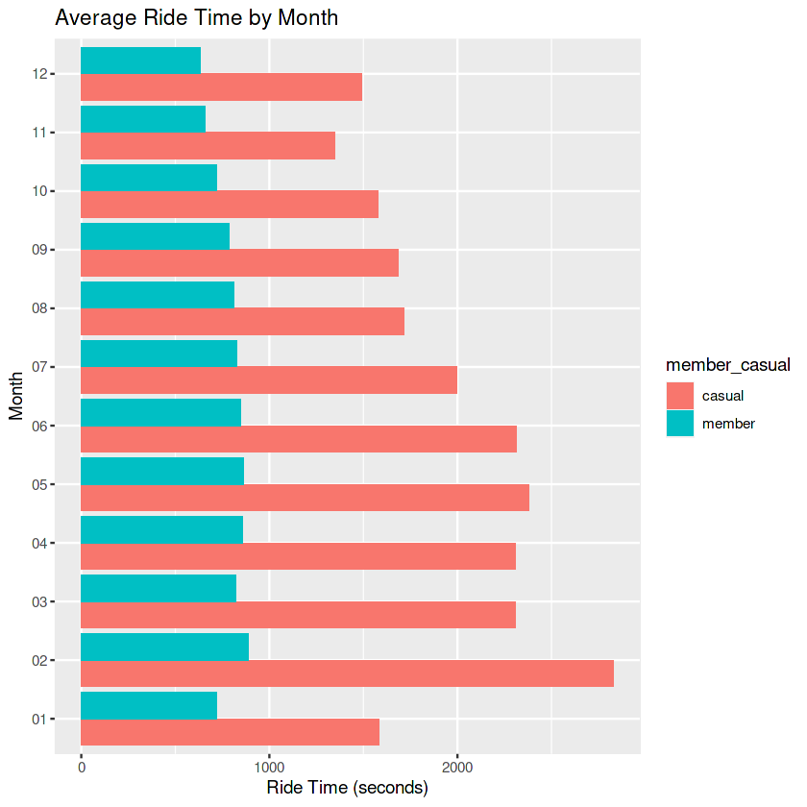
Analysis and Findings
From this image, you can see that the average ride time of casual riders are always high in the whole year 2021.

Slide 9
Some Recommendations
Casual rider who are most likely the weekend riders, company can offer them with some membership discount on getting subscription
Casual rider who rides least but for long distances weekly, company can offer them low ride prices on getting subscription
Casual rider who rides most but for short distances weekly, company can offer them some free rides on getting subscription
Casual rider who rides only in summertime, company can offer them special monthly subscription in summer months.

Slide 10
Conclusion and Future Extension
This was an amazing project with hands on experience with a fictional company, but I have learned a lot through this project. From data cleaning to data formatting and visualization, this project gives all the required experience to work with data related projects in the coming future.
We can extend our findings by using some other information like bike type used by both riders and by using location information such that from which source station to destination station, casual riders mostly rides.

Slide 11

Thank You

